Slide 1
OSI Transport Layer
Network Fundamentals – Chapter 4

Slide 2
Objectives
Explain the role of Transport Layer protocols and services in supporting communications across data networks
Analyze the application and operation of TCP mechanisms that support reliability
Analyze the application and operation of TCP mechanisms that support reassembly and manage data loss.
Analyze the operation of UDP to support communicate between two processes on end devices

Slide 3
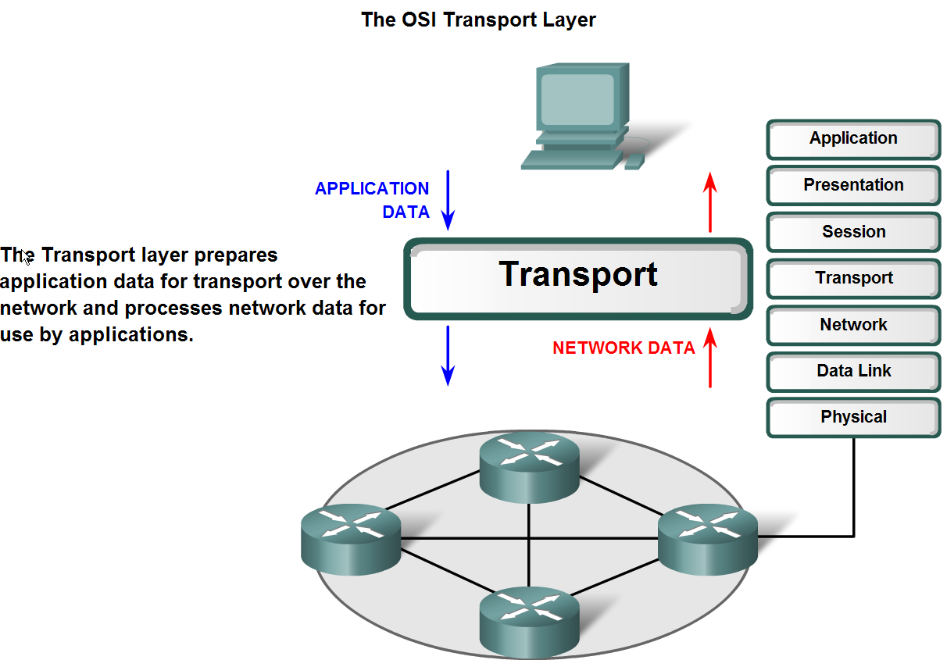
Transport Layer Role and Services
Explain the purpose of the Transport layer

Slide 4
Transport Layer Functions
The Transport layer provides for the segmentation of data and the control necessary to reassemble these pieces into the various communication streams. Its primary responsibilities to accomplish this are:
Tracking the individual communication between applications on the source and destination hosts
Segmenting data and managing each piece
Reassembling the segments into streams of application data
Identifying the different applications

Slide 5
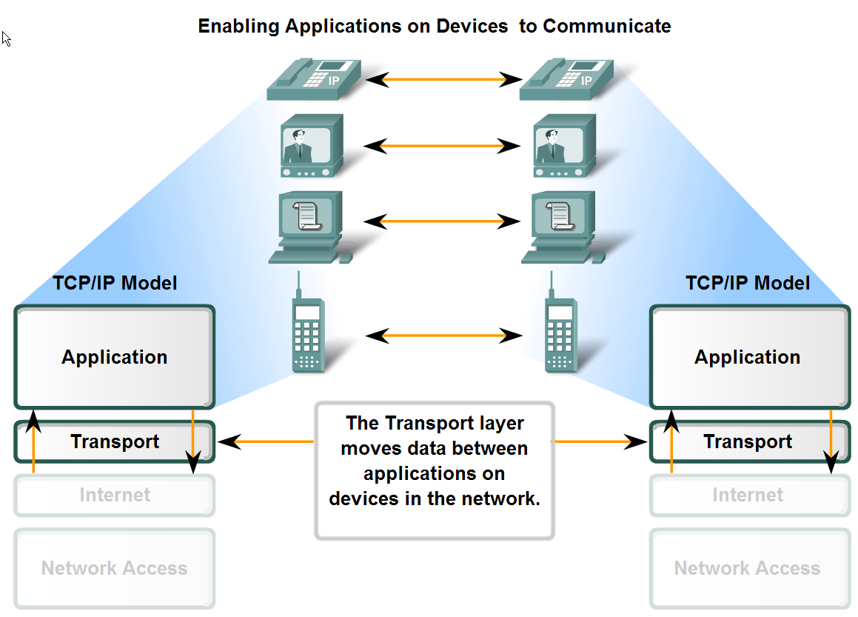
Transport Layer Role and Services
Major functions of the transport layer and the role it plays in data networks

Slide 6
1. Tracking Individual Conversations
Any host may have multiple applications that are communicating across the network.
Each of these applications will be communicating with one or more applications on remote hosts.
It is the responsibility of the Transport layer to maintain the multiple communication streams between these applications.

Slide 7
2. Segmenting Data
As each application creates a stream data to be sent to a remote application, this data must be prepared to be sent across the media in manageable pieces.
The Transport layer protocols describe services that segment this data from the Application layer.
This includes the encapsulation required on each piece of data.
Each piece of application data requires headers to be added at the Transport layer to indicate to which communication it is associated.

Slide 8
3. Reassembling Segments
At the receiving host, each piece of data may be directed to the appropriate application.
Additionally, these individual pieces of data must also be reconstructed into a complete data stream that is useful to the Application layer.
The protocols at the Transport layer describe the how the Transport layer header information is used to reassemble the data pieces into streams to be passed to the Application layer.

Slide 9
4. Identifying Applications
In order to pass data streams to the proper applications, the Transport layer must identify the target application.
To accomplish this, the Transport layer assigns an application an identifier. The TCP/IP protocols call this identifier a port number.
This port number is used in the Transport layer header to indicate to which application that piece of data is associated.
Applications do not need to know the operational details of the network in use.
The applications generate data that is sent from one application to another, without regard to the destination host type, the type of media over which the data must travel, the path taken by the data, the congestion on a link, or the size of the network.

Slide 10
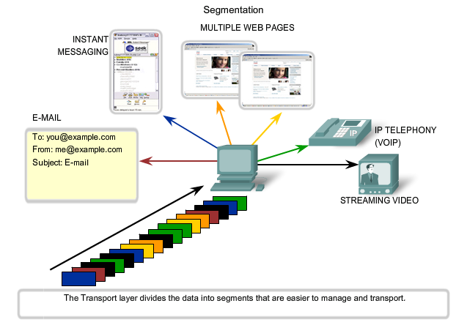
Segmentation

Slide 11
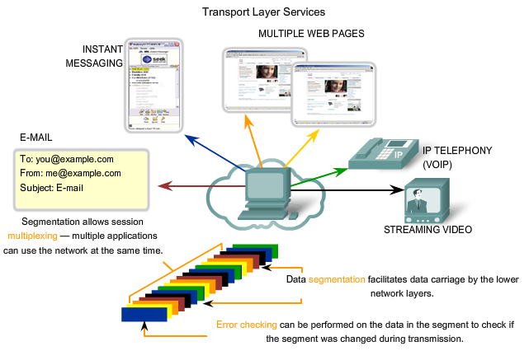
Transport Layer Services

Slide 12
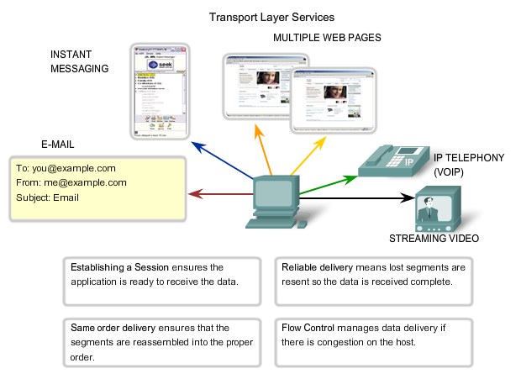
Services in Action

Slide 13
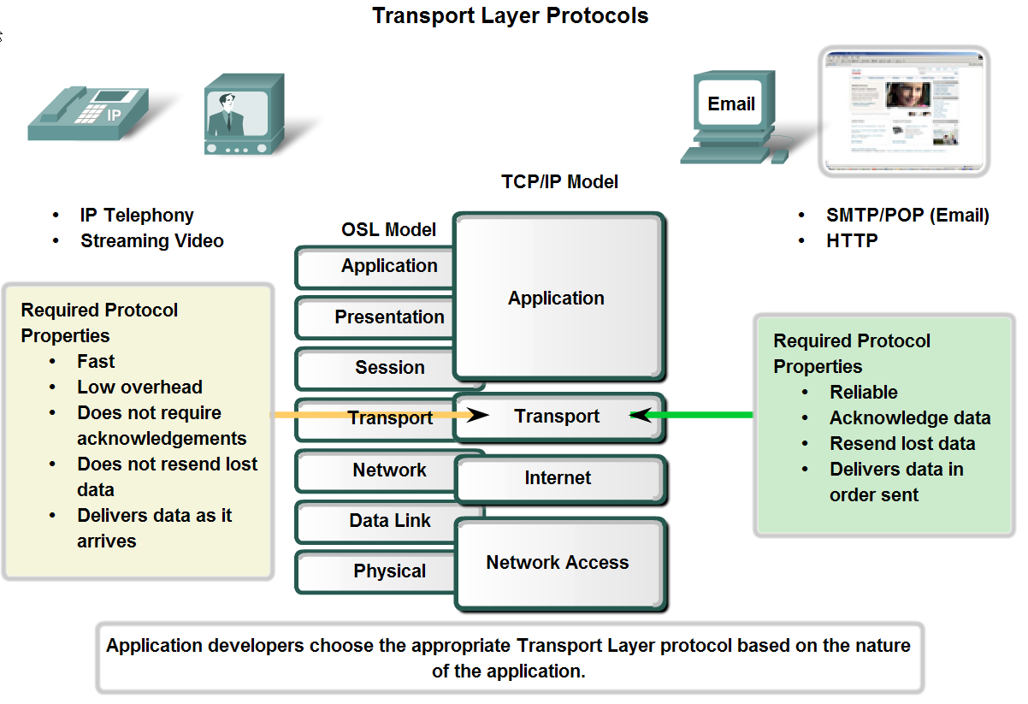
Transport Layer Role and Services
Supporting Reliable Communication

Slide 14
Transport Layer Operations
At the Transport layer the three basic operations of reliability are:
tracking transmitted data
acknowledging received data
retransmitting any unacknowledged data
These reliability processes place additional overhead on the network resources due to the acknowledgement, tracking, and retransmission.
This creates a trade-off between the value of reliability and the burden it places on the network.
Application developers must choose which transport protocol type is appropriate based on the requirements of their applications

Slide 15
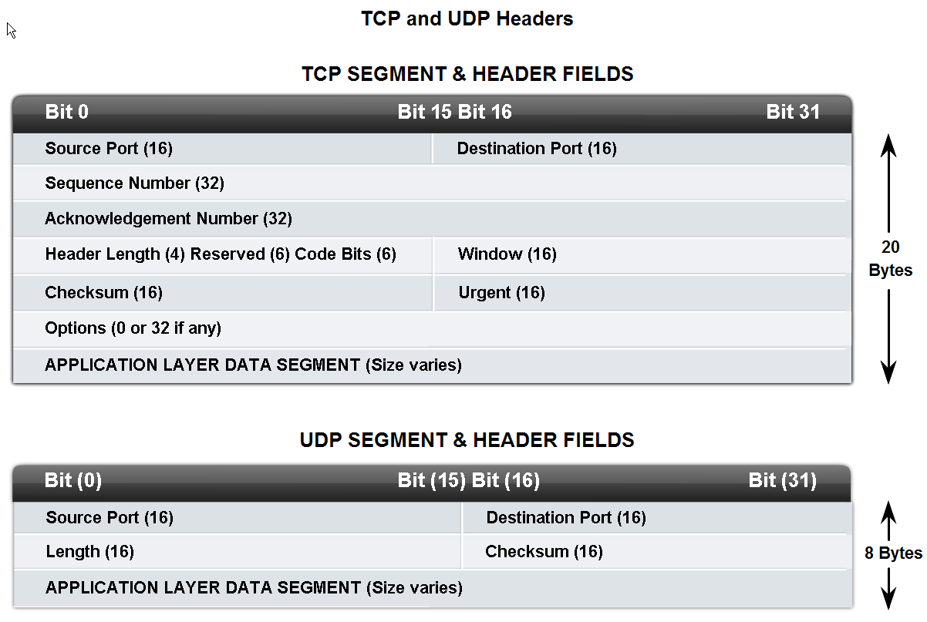
Transport Layer Role and Services
Identify the basic characteristics of the UDP and TCP protocols

Slide 16
UDP
UDP is a simple, connectionless protocol, described in RFC 768. It has the advantage of providing for low overhead data delivery.
The pieces of communication in UDP are called datagrams.
These datagrams are sent as "best effort" by this Transport layer protocol.
Applications that use UDP include:
Domain Name System (DNS)
Video Streaming
Voice over IP (VoIP)

Slide 17
TCP
TCP is a connection-oriented protocol, described in RFC 793. TCP incurs additional overhead to gain functions.
Additional functions specified by TCP are the same order delivery, reliable delivery, and flow control.
Each TCP segment has 20 bytes of overhead in the header encapsulating the Application layer data, whereas each UDP segment only has 8 bytes of overhead.
Applications that use TCP are:
Web Browsers
E-mail and File Transfers

Slide 18
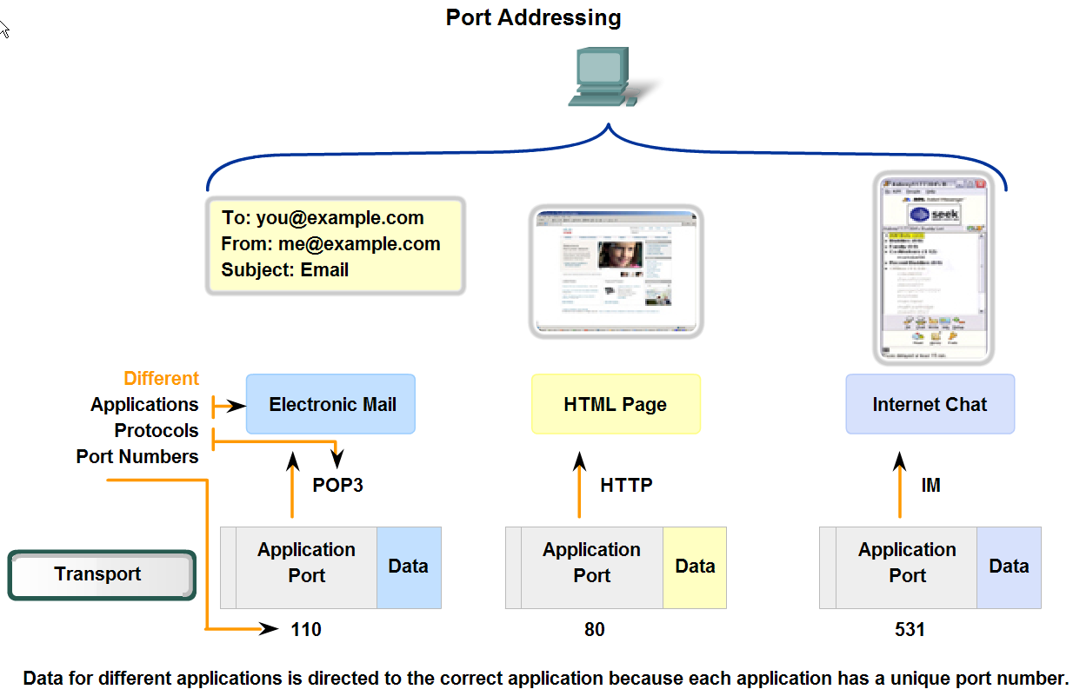
Transport Layer Role and Services
Identify how a port number is represented and describe the role port numbers play in the TCP and UDP protocols.

Slide 19
Transport Port Numbers
In the header of each segment or datagram, there is a source and destination port.
The source port number is the number for this communication associated with the originating application on the local host.
The destination port number is the number for this communication associated with the destination application on the remote host.
The combination of the Transport layer port number and the Network layer IP address assigned to the host uniquely identifies a particular process running on a specific host device. This combination is called a socket.
A socket pair, consisting of the source and destination IP addresses and port numbers, is also unique and identifies the conversation between the two hosts.

Slide 20
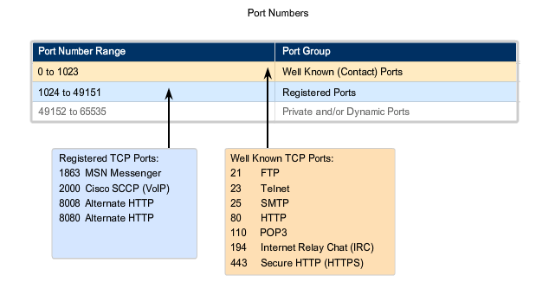
TCP Port Numbers
Dynamic Ports - Also known as Ephemeral Ports, these are usually assigned dynamically to client applications when initiating a connection. It is not very common for a client to connect to a service using a Dynamic or Private Port

Slide 21
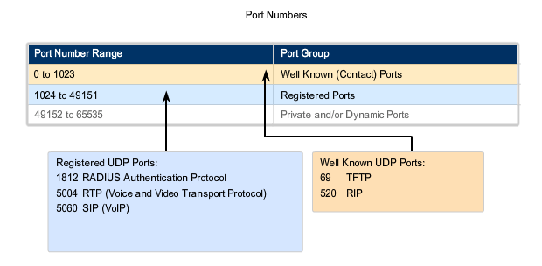
UDP Port Numbers

Slide 22
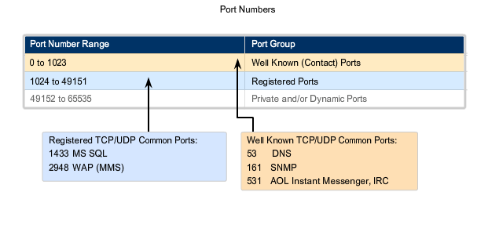
UDP and TCP Port Numbers

Slide 23
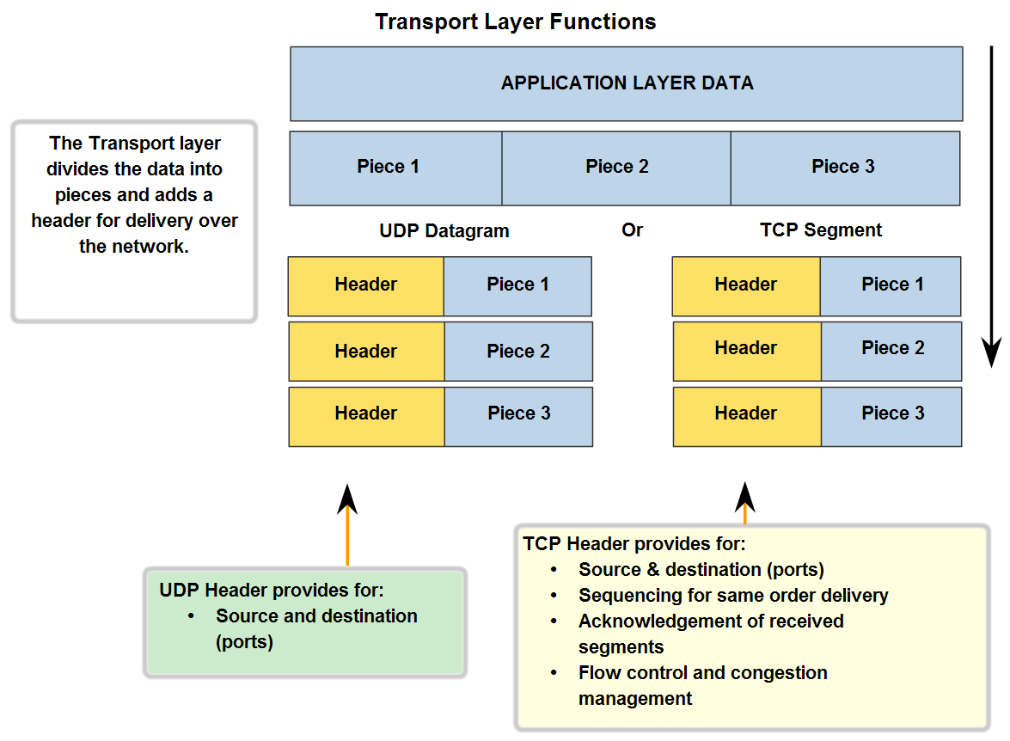
Transport Layer Role and Services
Describe the role of segments in the transport layer and the two principle ways segments can be marked for reassembly.

Slide 24
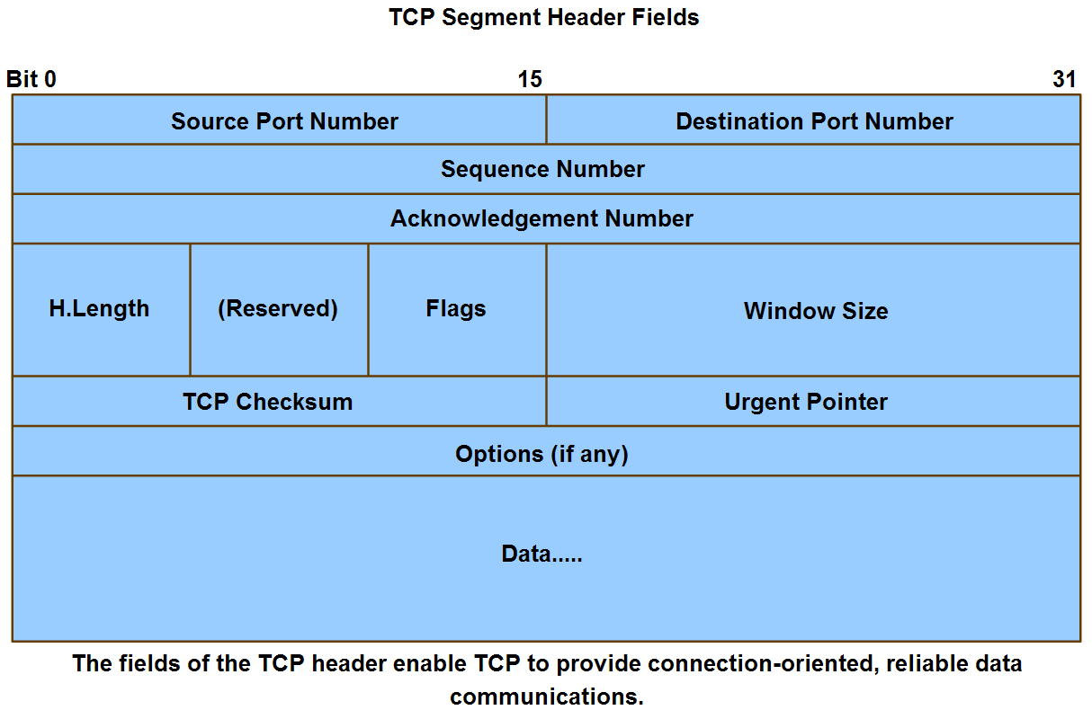
Application and Operation of TCP Mechanisms
Trace the steps that show how the TCP reliability mechanism works as part of a session

Slide 25
Reliability
The key distinction between TCP and UDP is reliability. The reliability of TCP communication is performed using connection-oriented sessions.
Before a host using TCP sends data to another host, the Transport layer initiates a process to create a connection with the destination.
This connection enables the tracking of a session, or communication stream between the hosts.
This process ensures that each host is aware of and prepared for the communication. A complete TCP conversation requires the establishment of a session between the hosts in both directions.
After a session has been established, the destination sends acknowledgements to the source for the segments that it receives.
If the source does not receive an acknowledgement within a predetermined amount of time, it retransmits that data to the destination.

Slide 26
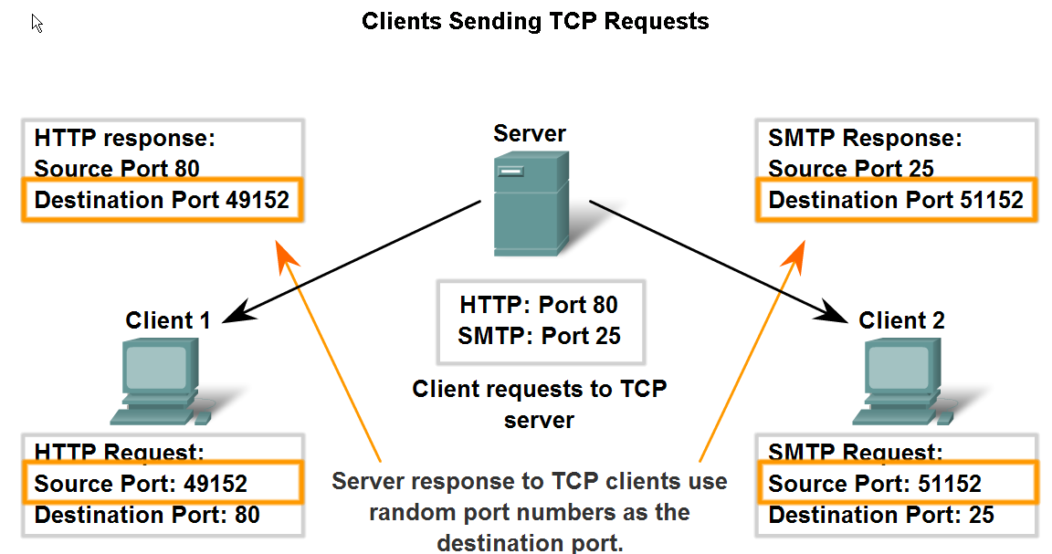
Application and Operation of TCP Mechanisms
Describe the role of port numbers in establishing TCP sessions and directing segments to server process

Slide 27
Server Services
Each application process running on the server is configured to use a port number, either by default or manually by a system administrator.
An individual server cannot have two services assigned to the same port number within the same Transport layer services.
A host running a web server application and a file transfer application cannot have both configured to use the same port (for example, TCP port 8080).
It is common for a server to provide more than one service, such as a web server and an FTP server, at the same time.

Slide 28
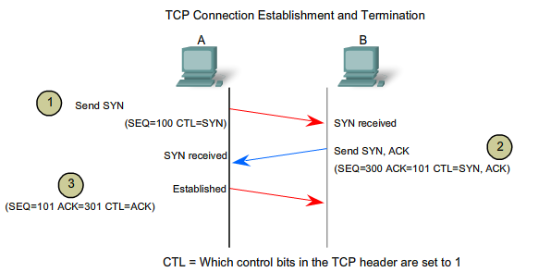
3 Way Handshake

Slide 29
Step 1
A TCP client begins the three-way handshake by sending a segment with the SYN (Synchronize Sequence Number) control flag set, indicating an initial value in the sequence number field in the header.
This initial value for the sequence number, known as the Initial Sequence Number (ISN), is randomly chosen and is used to begin tracking the flow of data from the client to the server for this session.
The ISN in the header of each segment is increased by one for each byte of data sent from the client to the server as the data conversation continues.

Slide 30
Step 2
The TCP server needs to acknowledge the receipt of the SYN segment from the client to establish the session from the client to the server.
To do so, the server sends a segment back to the client with the ACK flag set indicating that the Acknowledgment number is significant.
With this flag set in the segment, the client recognizes this as an acknowledgement that the server received the SYN from the TCP client.
The value of the acknowledgment number field is equal to the client initial sequence number plus 1. This establishes a session from the client to the server. The ACK flag will remain set for the balance of the session.

Slide 31
Step 3
Finally, the TCP client responds with a segment containing an ACK that is the response to the TCP SYN sent by the server.
There is no user data in this segment. The value in the acknowledgment number field contains one more than the initial sequence number received from the server.
Once both sessions are established between client and server, all additional segments exchanged in this communication will have the ACK flag set.

Slide 32
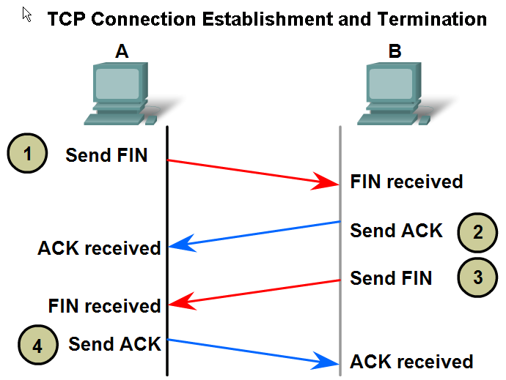
Application and Operation of TCP Mechanisms
Trace the steps in the handshake in the establishment of TCP sessions

Slide 33
Three-way handshake
To establish the connection, the hosts perform a three-way handshake. Control bits in the TCP header indicate the progress and status of the connection. The three-way handshake:
Establishes that the destination device is present on the network
Verifies that the destination device has an active service and is accepting requests on the destination port number that the initiating client intends to use for the session
Informs the destination device that the source client intends to establish a communication session on that port number

Slide 34
Steps in Action
The initiating client sends a segment containing an initial sequence value, which serves as a request to the server to begin a communications session.
The server responds with a segment containing an acknowledgement value equal to the received sequence value plus 1, plus its own synchronizing sequence value. The value is one greater than the sequence number because the ACK is always the next expected Byte or Octet. This acknowledgement value enables the client to tie the response back to the original segment that it sent to the server.
Initiating client responds with an acknowledgement value equal to the sequence value it received plus one. This completes the process of establishing the connection.
Diagram

Slide 35
Control Information
Within the TCP segment header, there are six 1-bit fields that contain control information used to manage the TCP processes. Those fields are:
URG - Urgent pointer field significant
ACK - Acknowledgement field significant
PSH - Push function
RST - Reset the connection
SYN - Synchronize sequence numbers
FIN - No more data from sender

Slide 36
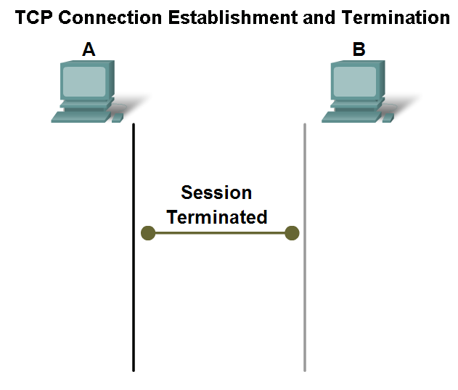
Application and Operation of TCP Mechanisms
Trace the steps in the handshake in the termination of TCP sessions

Slide 37
Closing a Connection
To close a connection, the FIN (Finish) control flag in the segment header must be set.
To end each one-way TCP session, a two-way handshake is used, consisting of a FIN segment and an ACK segment.
Therefore, to terminate a single conversation supported by TCP, four exchanges are needed to end both sessions
When the client has no more data to send in the stream, it sends a segment with the FIN flag set.
The server sends an ACK to acknowledge the receipt of the FIN to terminate the session from client to server.
The server sends a FIN to the client, to terminate the server to client session.
The client responds with an ACK to acknowledge the FIN from the server.

Slide 38
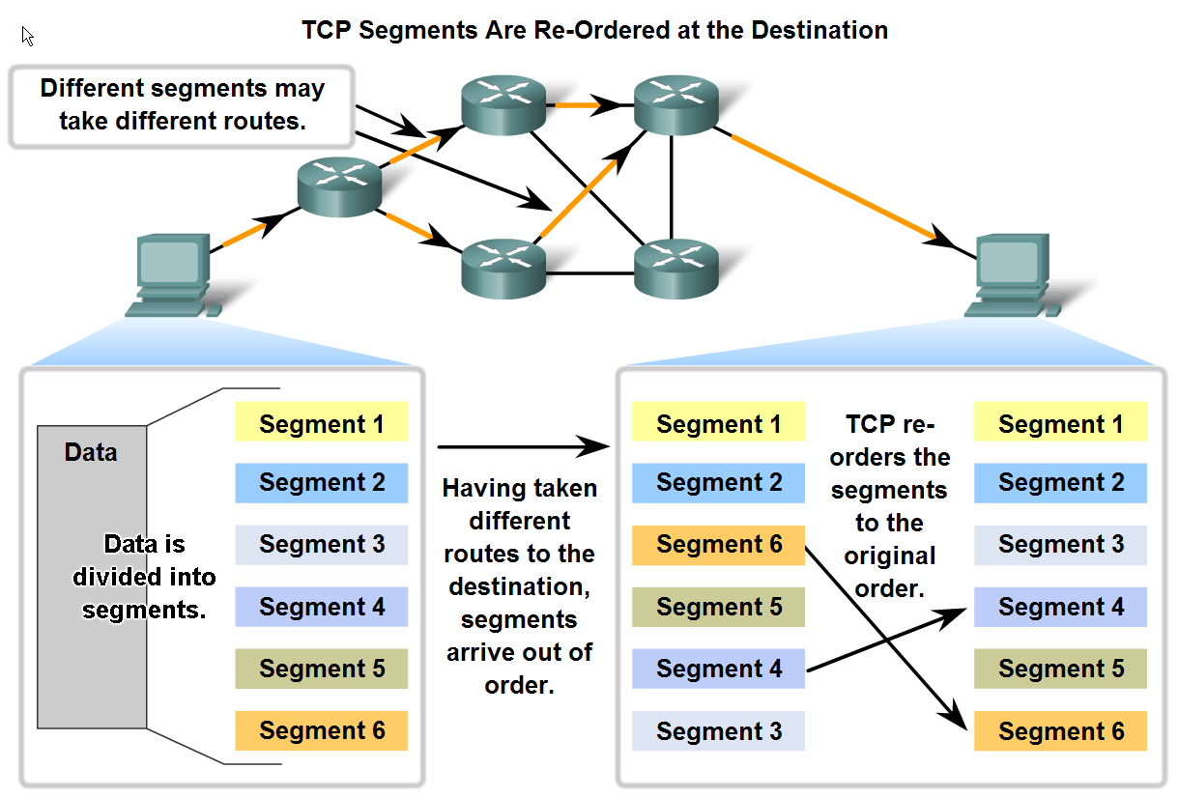
Managing TCP Sessions
Describe how TCP sequence numbers are used to reconstruct the data stream with segments placed in the correct order

Slide 39
Managing Sequence Numbers
Segment sequence numbers enable reliability by indicating how to reassemble and reorder received segments, as shown in the figure.
The receiving TCP process places the data from a segment into a receiving buffer. Segments are placed in the proper sequence number order and passed to the Application layer when reassembled.
Any segments that arrive with non-contiguous sequence numbers are held for later processing.
Then, when the segments with the missing bytes arrive, these segments are processed.

Slide 40
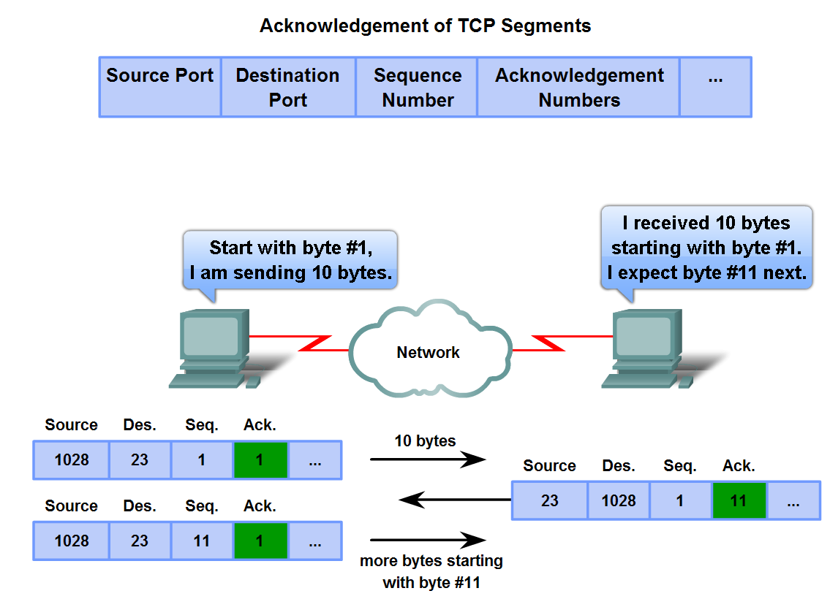
Managing TCP Sessions
Trace the steps used by the TCP protocol in which sequence numbers and acknowledgement numbers are used to manage exchanges in a conversation

Slide 41
Managing Acknowledgements
The sequence number is the relative number of bytes that have been transmitted in this session plus 1 (which is the number of the first data byte in the current segment).
TCP uses the acknowledgement number in segments sent back to the source to indicate the next byte in this session that the receiver expects to receive.
This is called expectational acknowledgement.
The source is informed that the destination has received all bytes in this data stream up to, but not including, the byte indicated by the acknowledgement number.
The sending host is expected to send a segment that uses a sequence number that is equal to the acknowledgement number.

Slide 42
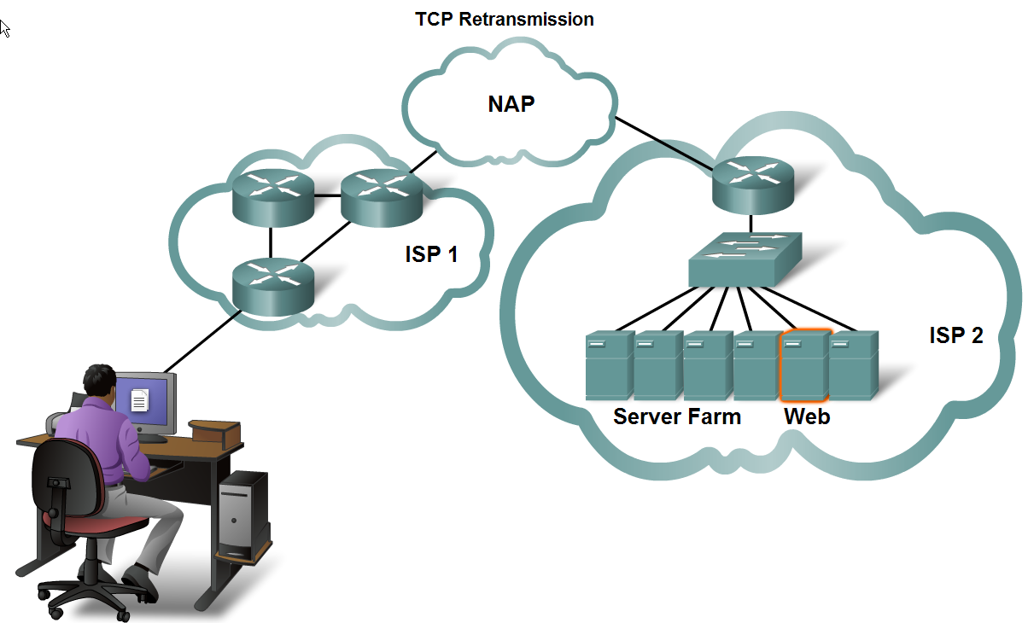
Managing TCP Sessions
Describe the retransmission.remedy for lost data employed by TCP

Slide 43
Handling Retransmissions
A destination host service using TCP usually only acknowledges data for contiguous sequence bytes. If one or more segments are missing, only the data in the segments that complete the stream are acknowledged.
For example, if segments with sequence numbers 1500 to 3000 and 3400 to 3500 were received, the acknowledgement number would be 3001. This is because there are segments with the sequence numbers 3001 to 3399 that have not been received.
When TCP at the source host has not received an acknowledgement after a predetermined amount of time, it will go back to the last acknowledgement number that it received and retransmit data from that point forward.

Slide 44
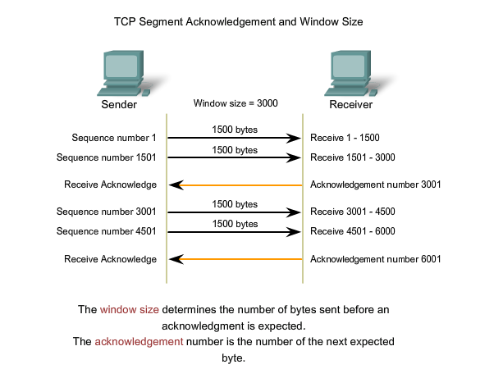
Flow Control with Window Size

Slide 45
Flow Control
TCP also provides mechanisms for flow control. Flow control assists the reliability of TCP transmission by adjusting the effective rate of data flow between the two services in the session.
When the source is informed that the specified amount of data in the segments is received, it can continue sending more data for this session.
This Window Size field in the TCP header specifies the amount of data that can be transmitted before an acknowledgement must be received. The initial window size is determined during the session startup via the three-way handshake.

Slide 46
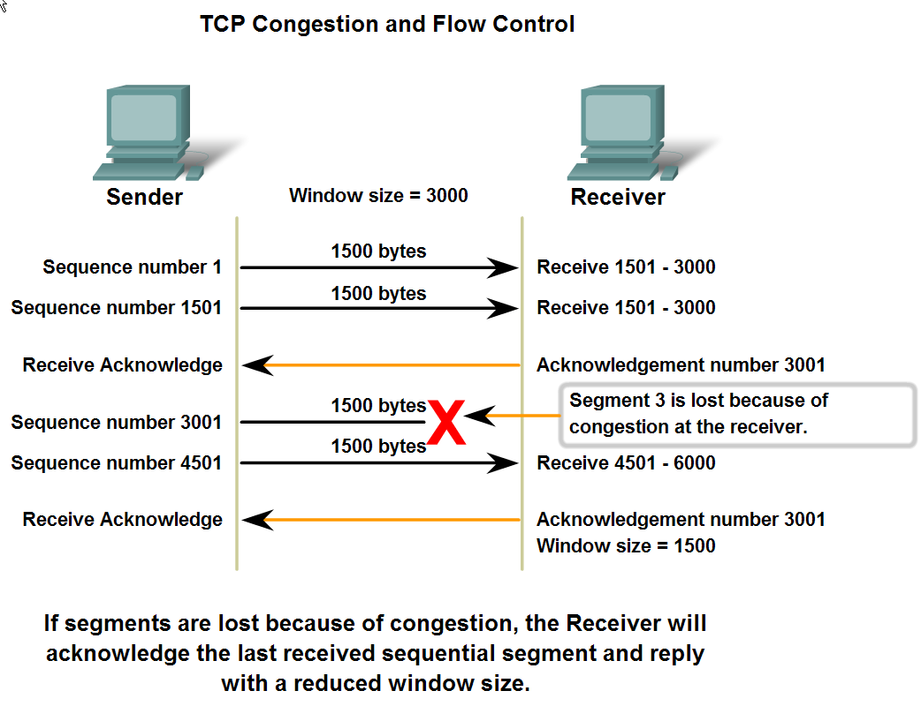
Managing TCP Sessions
Describe the mechanisms in TCP that manage the interrelationship between window size, data loss and congestion during a session

Slide 47
Reducing Window Size
If a receiving host has congestion, it may respond to the sending host with a segment with a reduced window size. In this graphic, there was a loss of one of the segments.
The receiver changed the window field in the TCP header of the returning segments in this conversation from 3000 down to 1500. This caused the sender to reduce the window size to 1500.
After periods of transmission with no data losses or constrained resources, the receiver will begin to increase the window field.
This reduces the overhead on the network because fewer acknowledgments need to be sent. Window size will continue to increase until there is data loss, which will cause the window size to be decreased.

Slide 48
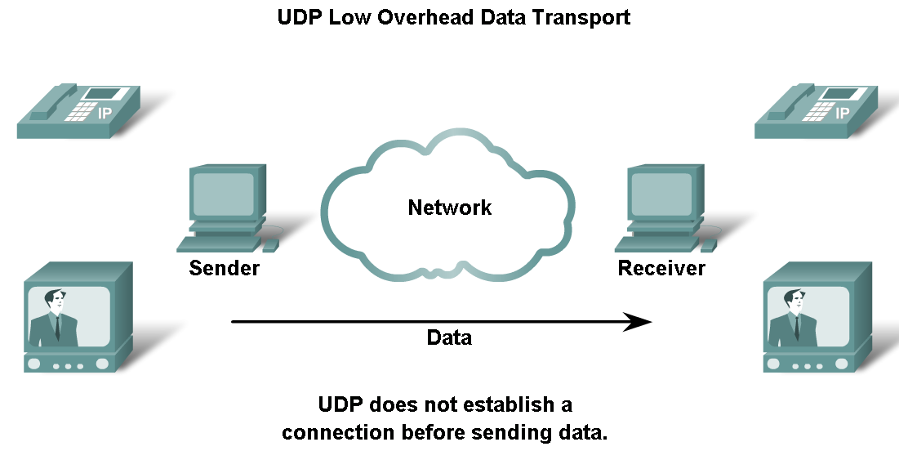
UDP Protocol
Describe the characteristics of the UDP protocol and the types of communication for which it is best suited

Slide 49
UDP Protocol
UDP is a simple protocol that provides the basic Transport layer functions.
It much lower overhead than TCP, since it is not connection-oriented and does not provide the sophisticated retransmission, sequencing, and flow control mechanisms.
Although the total amount of UDP traffic found on a typical network is often relatively low, key Application layer protocols that use UDP include:
Domain Name System (DNS)
Simple Network Management Protocol (SNMP)
Dynamic Host Configuration Protocol (DHCP)
Routing Information Protocol (RIP)
Trivial File Transfer Protocol (TFTP)
Online games

Slide 50
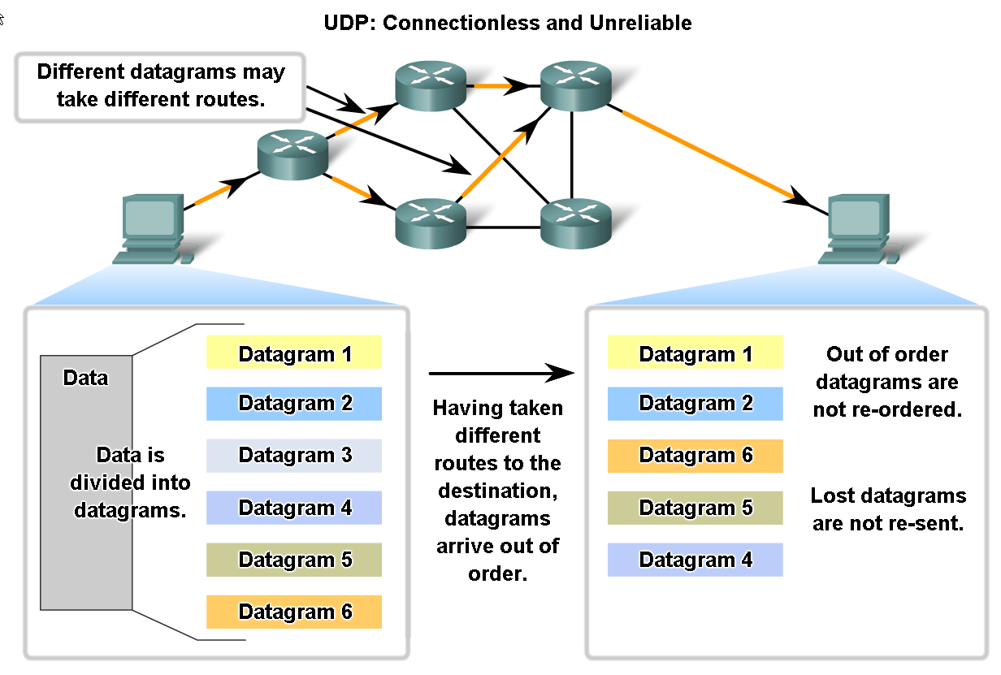
UDP Protocol
Describe in detail the process specified by the UDP protocol to reassemble PDUs at the destination device

Slide 51
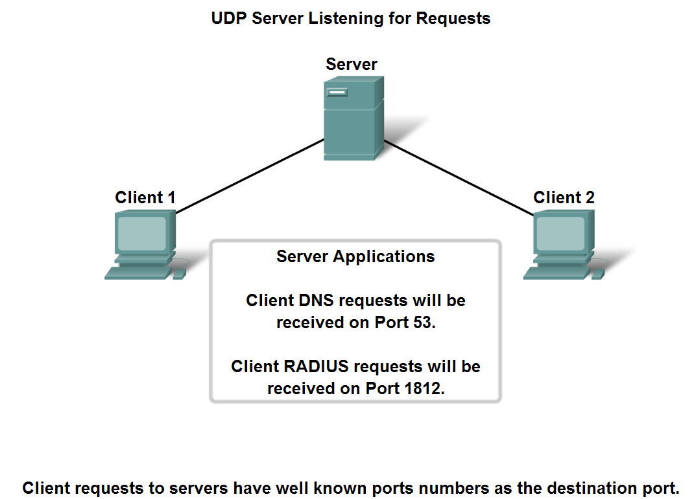
UDP Protocol
Describe how servers use port numbers to identify a specified application layer process and direct segments to the proper service or application

Slide 52
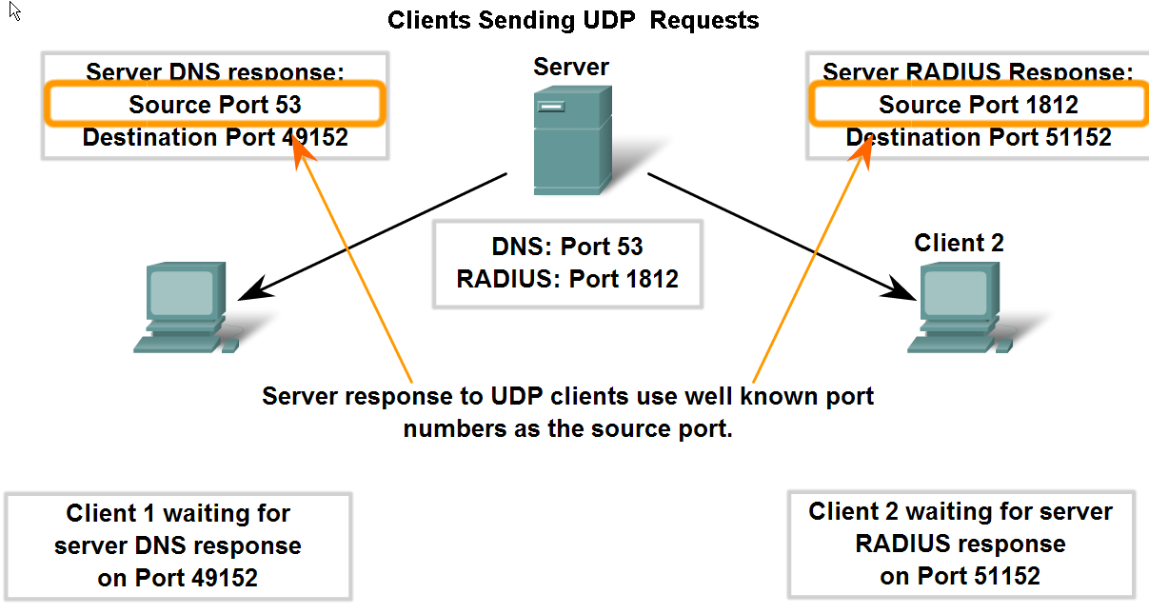
UDP Protocol
Trace the steps as the UDP protocol and port numbers are utilized in client-server communication.

Slide 53
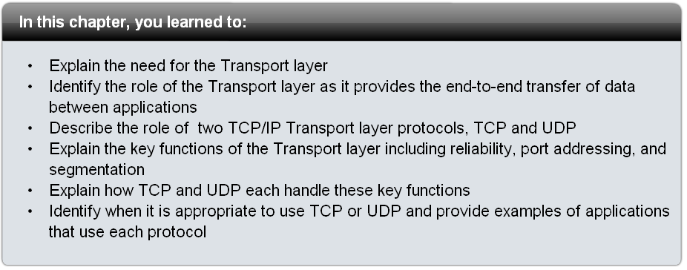
Summary

